Slide 1
Machine Learning

Slide 2
It is somewhat reminiscent of the famous statement by British mathematician and professor of statistics George E. P. Box that “all models are wrong, but some are useful”.
The goal of ML is never to make “perfect” guesses, because ML deals in domains where there is no such thing. The goal is to make guesses that are good enough to be useful.

Slide 3
What is machine learning?
A branch of artificial intelligence, concerned with the design and development of algorithms that allow computers to evolve behaviors based on empirical data.
As intelligence requires knowledge, it is necessary for the computers to acquire knowledge.

Slide 4
Defining the Learning Task
Improve on task, T, with respect to
performance metric, P, based on experience, E.
T: Playing checkers
P: Percentage of games won against an arbitrary opponent
E: Playing practice games against itself
T: Recognizing hand-written words
P: Percentage of words correctly classified
E: Database of human-labeled images of handwritten words
T: Driving on four-lane highways using vision sensors
P: Average distance traveled before a human-judged error
E: A sequence of images and steering commands recorded while
observing a human driver.
T: Categorize email messages as spam or legitimate.
P: Percentage of email messages correctly classified.
E: Database of emails, some with human-given labels

Slide 5
Learning system model
Testing
Input Samples
Learning Method
System
Training

Slide 6
Training and testing
Data acquisition
Practical usage
Universal set
(unobserved)
Training set (observed)
Testing set
(unobserved)

Slide 7
y = f(x)
Training: given a training set of labeled examples {(x₁,y₁), …, (x_{N},y_{N})}, estimate the prediction function f by minimizing the prediction error on the training set
Testing: apply f to a never before seen test example x and output the predicted value y = f(x)
output
prediction function
features
Slide credit: L. Lazebnik

Slide 8
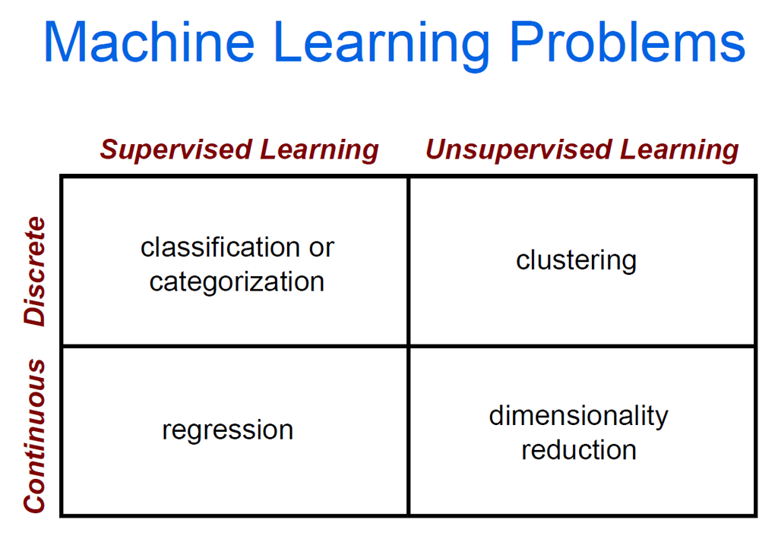

Slide 9


Algorithms
Supervised learning ( )
Prediction
Classification (discrete labels), Regression (real values)
Unsupervised learning ( )
Clustering
Probability distribution estimation
Finding association (in features)
Dimension reduction
Semi-supervised learning
Reinforcement learning
Decision making (robot, chess machine)

Slide 10
Reinforcement Learning
Reinforcement learning comes into play when examples of desired behavior are not available
But where it is possible to score examples of behavior according to some performance criterion
Consider a simple scenario. Mobile phone users sometimes resort to the following procedure to obtain good reception in a new locale where coverage is poor
We move around with the phone while monitoring its signal strength indicator or by repeating “Do you hear me now?” and carefully listening to the reply
We keep doing this until we either find a place with an adequate signal or until we find the best place we can under the circumstances, at which point we either try to complete the call or give up

Slide 11
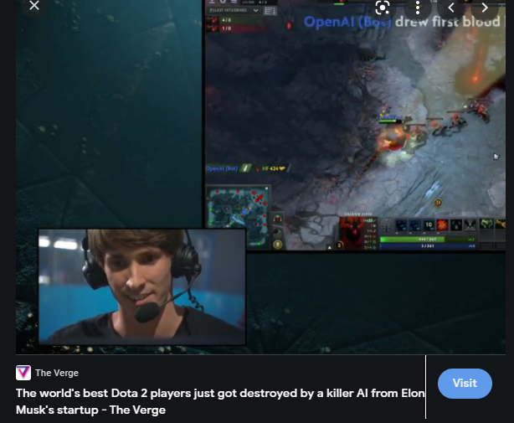

Slide 12
Reinforcement Learning
Here, the information we receive is not directly telling us where we should go to obtain good reception
Nor is each reading telling us in which direction we should move next Each reading simply allows us to evaluate the goodness of our current situation
We have to move around—explore—in order to decide where we should go. We are not given examples of correct behavior

Slide 13
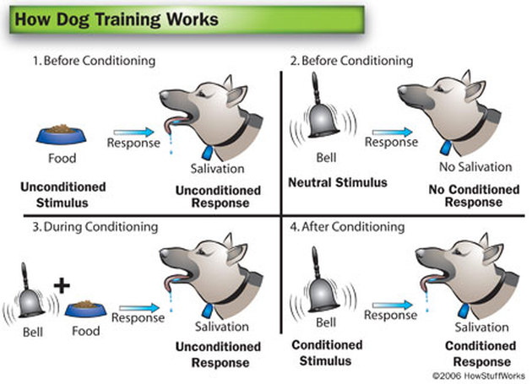

Slide 14
What is Data?
Collection of data objects and their attributes
An attribute is a property or characteristic of an instance
Examples: eye color of a person, temperature, etc.
Attribute is also known as variable, field, characteristic, or feature
A collection of attributes describe an instance
Instance is also known as record, point, case, sample, entity, or object
Attributes
Instances

Slide 15
Attributes (field, variable, feature)
Categorical: A finite number of discrete values.
The type nominal denotes that there is no ordering between the values, such as last names and colors.
The type ordinal denotes that there is an ordering, such as in an attribute taking on the values low, medium, or high
Continuous (quantitative) Commonly, subset of real numbers, where there is a measurable difference between the possible values.
Integers are usually treated as continuous in practical problem

Slide 16
Instance (example, case, record)
A single object of the world from which a model will be learned, or on which a model will be used (e.g., for prediction)
In most data mining work, instances are described by feature vectors
some work uses more complex representations (e.g., containing relations between instances or between parts of instances)

Slide 17
Record Data
Data that consists of a collection of records, each of which consists of a fixed set of attributes

Slide 18
Document Data
Each document becomes a `term' vector,
each term is a component (attribute) of the vector,
the value of each component is the number of times the corresponding term occurs in the document.

Slide 19
Transaction Data
A special type of record data, where
each record (transaction) involves a set of items.
For example, consider a grocery store. The set of products purchased by a customer during one shopping trip constitute a transaction, while the individual products that were purchased are the items.

Slide 20
Graph Data
Examples: Generic graph and HTML Links

Slide 21
Chemical Data
Benzene Molecule: C₆H₆

Slide 22
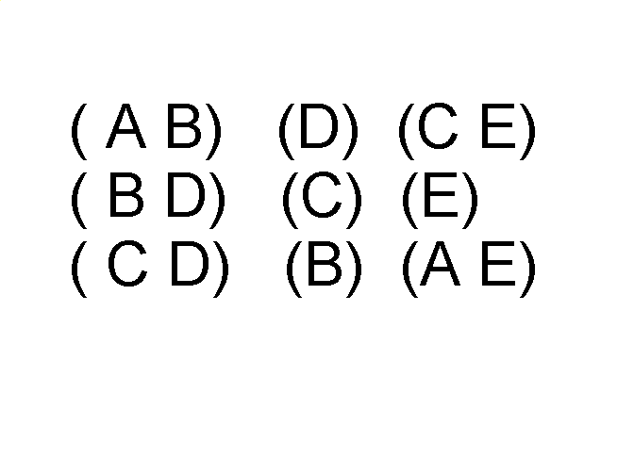
Ordered Data
Items/Events
Sequences of transactions
An element of the sequence

Slide 23
Ordered Data
Genomic sequence data

Slide 24
Ordered Data
Spatio-Temporal Data
Average Monthly Temperature of land and ocean

Slide 25
Instance Based Classifiers
First Example of Supervised Classification
Examples:
Rote-learner
Memorizes entire training data and performs classification only if attributes of record match one of the training examples exactly
Nearest neighbor
Uses k “closest” points (nearest neighbors) for performing classification

Slide 26
Instance-Based Classifiers
Store the training records
Use training records to predict the class label of unseen cases

Slide 27
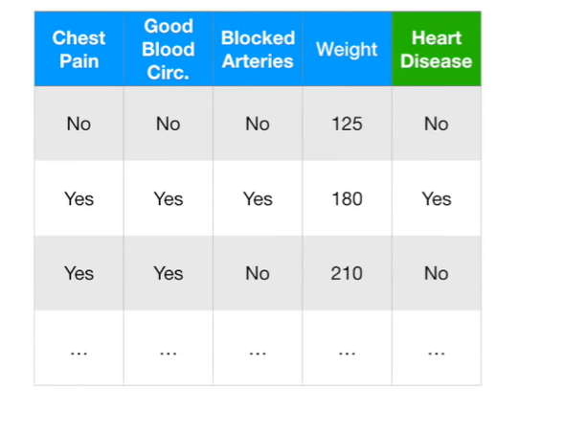
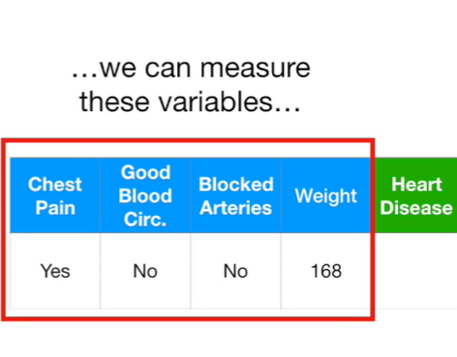

Slide 28
Things to decide
Which ML method would be best ?
Ans: Cross validate different ML methods to get sense of how well they work in practice.
1. Estimates the parameters for the ML method
2. Evaluate how well the ML method works
Estimating the parameters are know as “Training the Algo”
Evaluating is called “Testing the Algo”

Slide 29
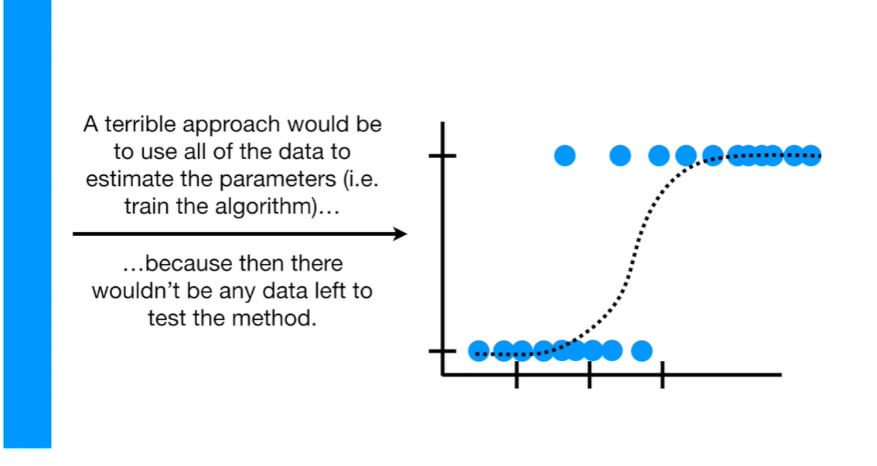

Slide 30
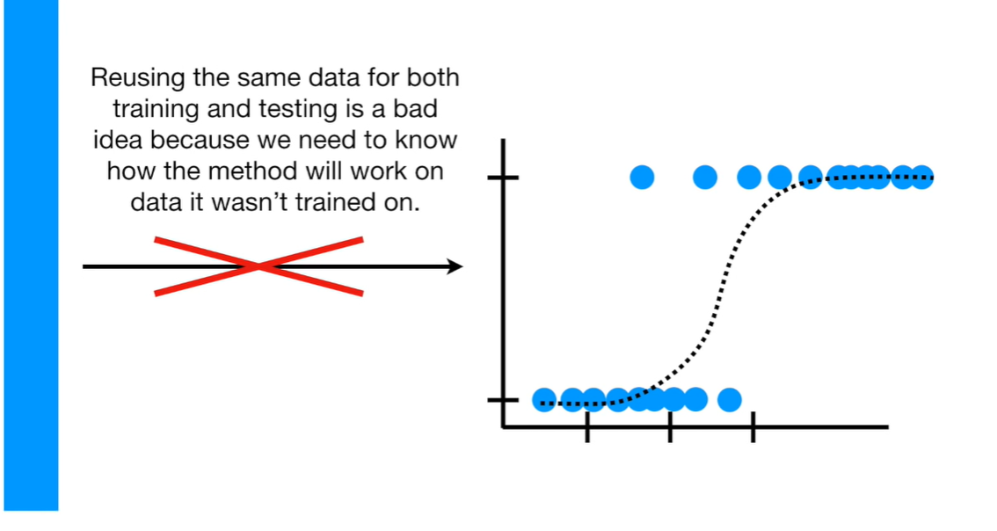

Slide 31
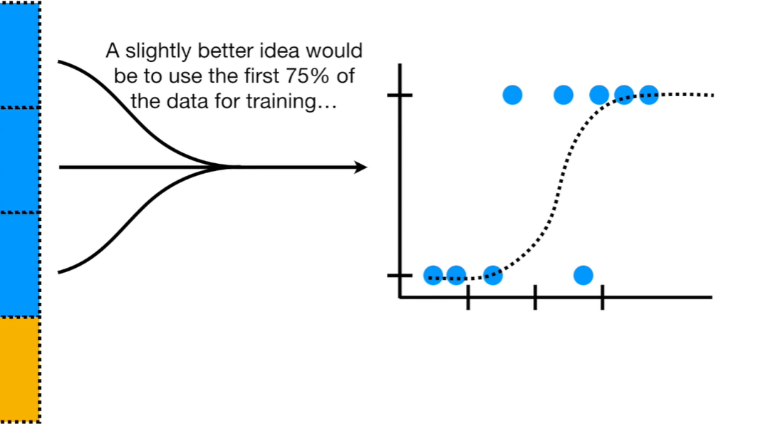
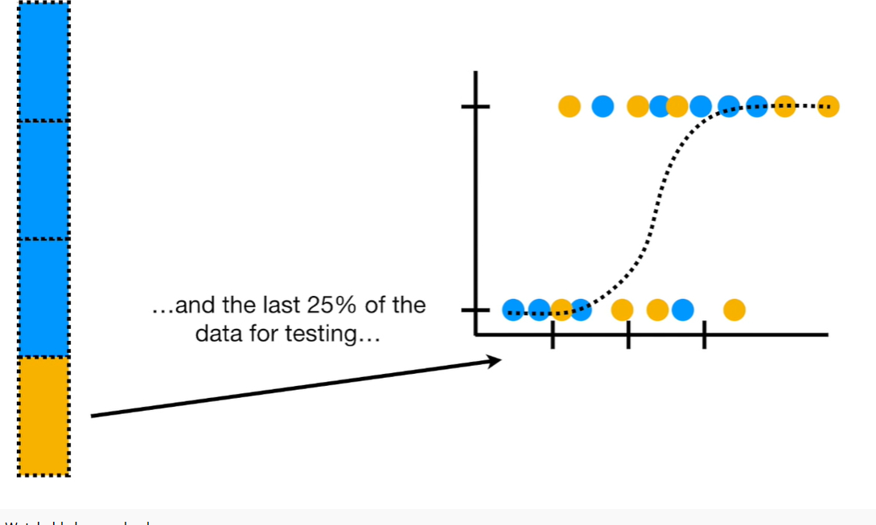

Slide 32
Training and testing
Training is the process of making the system able to learn.
No free lunch rule:
Training set and testing set come from the same distribution
Need to make some assumptions or bias

Slide 33
Assessing Performance
Training data performance is typically optimistic
e.g., error rate on training data
Reasons?
- classifier may not have enough data to fully learn the concept (but
on training data we don’t know this)
- for noisy data, the classifier may overfit the training data
In practice we want to assess performance “out of sample”
how well will the classifier do on new unseen data? This is the
true test of what we have learned (just like a classroom)
With large data sets we can partition our data into 2 subsets, train and test
- build a model on the training data
- assess performance on the test data
Notes:
33

Slide 34
Performance
There are several factors affecting the performance:
Types of training provided
The form and extent of any initial background knowledge
The type of feedback provided
The learning algorithms used
Two important factors:
Modeling
Optimization

Slide 35
Algorithms
The success of machine learning system also depends on the algorithms.
The algorithms control the search to find and build the knowledge structures.
The learning algorithms should extract useful information from training examples.

Slide 36
Algorithms
Supervised learning
Unsupervised learning
Semi-supervised learning

Slide 37
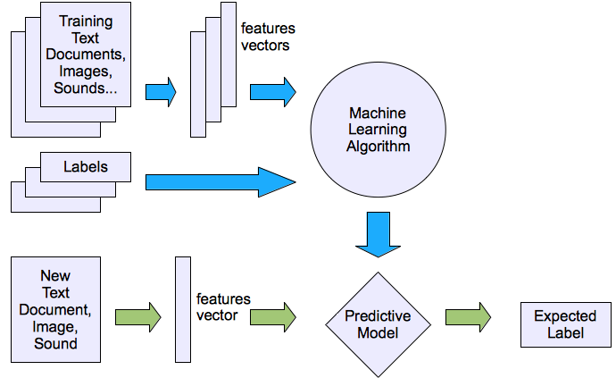
Machine learning structure
Supervised learning

Slide 38



The machine learning framework
Apply a prediction function to a feature representation of the image to get the desired output:
f( ) = “apple”
f( ) = “tomato”
f( ) = “cow”
Slide credit: L. Lazebnik

Slide 39

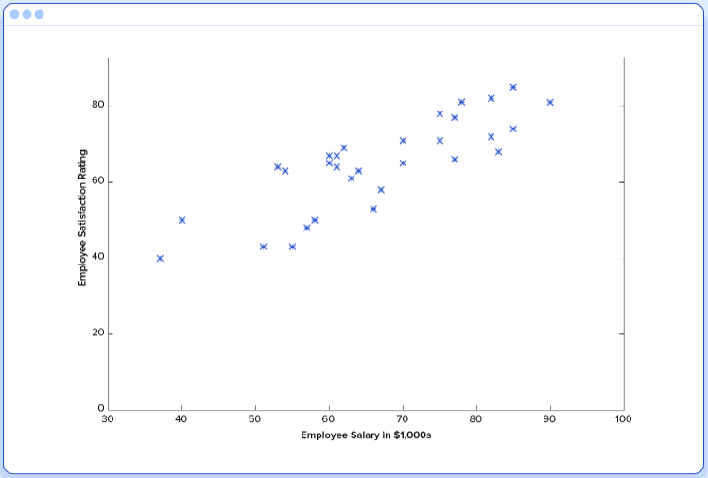

Slide 40

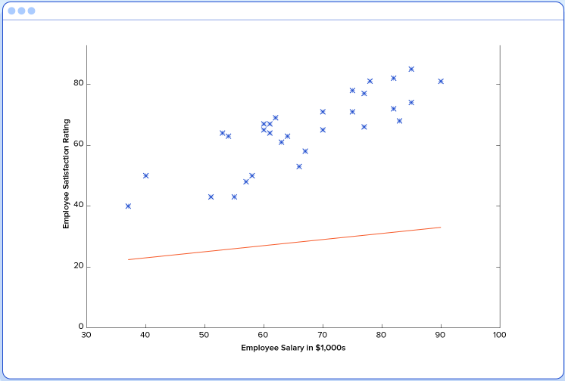

Slide 41

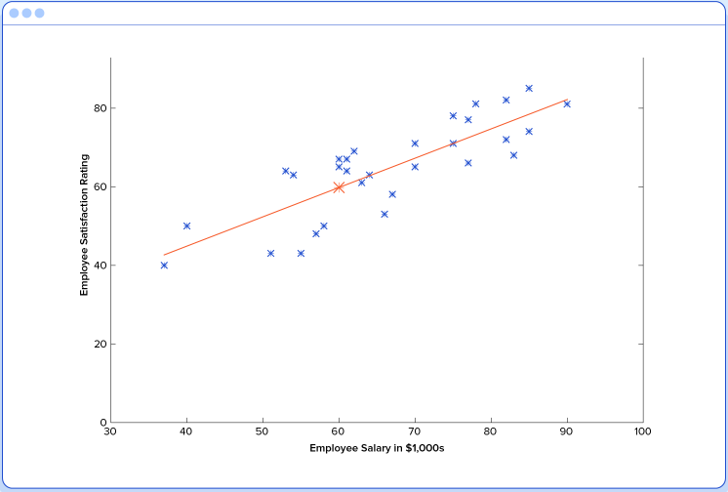

Slide 42
Regression machine learning systems: Systems where the value being predicted falls somewhere on a continuous spectrum. These systems help us with questions of “How much?” or “How many?”.
Multi-target: More than one continuous target variable
Classification machine learning systems: Systems where we seek a yes-or-no prediction, such as “Is this tumor cancerous?”, “Does this cookie meet our quality standards?”, and so on.
Multiclass (mutually exclusive class assignments) , multilabel (data point can lie in more than one classes)

Slide 43
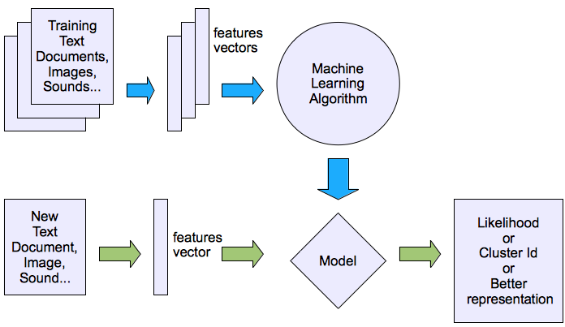
Machine learning structure
Unsupervised learning

Slide 44
Semi-supervised learning
“We expect unsupervised learning to become far more important in the longer term. Human and animal learning is largely unsupervised: we discover the structure of the world by observing it, not by being told the name of every object.” LeCun, Bengio, Hinton, Nature (2015)
Semi-supervised learning algorithms are trained on a combination of labeled and unlabeled data
Semi-supervised learning uses the unlabeled data to gain more understanding of the population structure in general
The process of labeling massive amounts of data for supervised learning is often prohibitively time-consuming and expensive.
What’s more, too much labeling can impose human biases on the model

Slide 45
Choosing an Evaluation Metrics
How do you evaluate the result of your model?
Some misclassifications are worse than others
False negatives may be worse than false positive
A domain expert can decide the evaluation metrics

Slide 46
Confusion Matrix
In the field of machine learning, a confusion matrix is a specific table layout that allows visualization of the performance of an algorithm
 | Predicted Negative | Predicted Positive
Actual Negative | True Negative | False Positive
Actual Positive | False Negative | True Positive

Slide 47
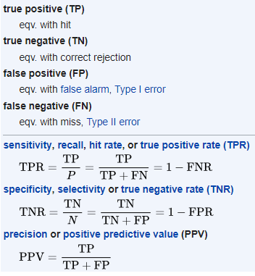
Choosing an Evaluation Metrics
To evaluate the efficiency of your model
Needs domain expertise
It is a tradeoff between sensitivity and specificity
Sensitivity (True Positive Rate)
Correctly marking a positive as positive
Also known as recall
Specificity (True Negative Rate)
Correctly marking a negative as negative

Slide 48
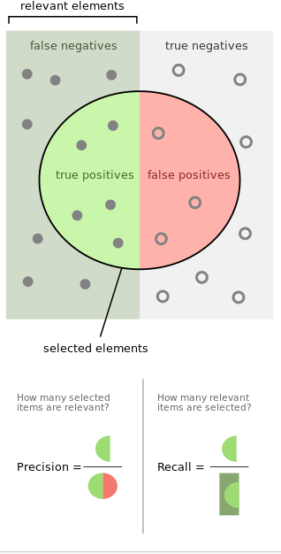

Slide 49

F- measure

Slide 50
Choosing an Evaluation Metrics
One possibility is accuracy: which is the ratio of number of correct labels to the total number of labels
Misclassification rate = 1 – accuracy
How to determine value of k?
The one which gives minimum misclassification rate

Slide 51
Confusion Matrix
TN is the number of correct predictions that an instance is negative
FP is the number of incorrect predictions that an instance is positive
FN is the number of incorrect predictions that an instance is negative
TP is the number of correct predictions that an instance is positive

Slide 52
Confusion Matrix
Several standard terms have been defined for the 2 class matrix
The accuracy (AC) is the proportion of the total number of predictions that were correct
Accuracy = 3 / 4 = 75%

Slide 53
Confusion Matrix
The recall or true positive rate (TPR) is the proportion of positive cases that were correctly identified
The false positive rate (FPR) is the proportion of negatives cases that were incorrectly classified as positive
TPR or recall = 2 / 3 = 66.7%
FPR = 0 / 1 = 0 %

Slide 54
Confusion Matrix
The true negative rate (TNR) is defined as the proportion of negatives cases that were classified correctly,
The false negative rate (FNR) is the proportion of positives cases that were incorrectly classified as negative
TNR = 1 / 1 = 100%
FNR = 1 / 3 = 33.3%

Slide 55
Confusion Matrix
precision (P) is the proportion of the predicted positive cases that were correct,
precision = 2/2 = 100%
F measure is harmonic mean of precision and recall
F1 = (2 * 1 * 0.667)/(1+0.667) = 0.8

Slide 56
Cross Validation
Divide data into training set (80%) and test set (20%)
Find values of parameters by using training set and calculate MSE
Calculate MSE for TEST set as well
If both values of MSE are approximately the same, then it is a good model

Slide 57
References
An overview of ML: Speaker: Yi-Fan Chang
Slides: Isabelle Guyon, Erik Sudderth, Mark Johnson,Derek Hoiem, Lana Lazebnik
https://www.toptal.com/machine-learning/machine-learning-theory-an-introductory-primer
IST 511 Information Management: Information and TechnologyMachine Learning, Dr. C. Lee Giles, David Reese Professor, College of Information Sciences and Technology
Wikipedia
https://pdfs.semanticscholar.org/1c54/68ca9da39aaf7ba8850c0eafd8c86acf5c09.pdf

Slide 58
References
Introduction to Data Mining by Tan, Steinbach, Kumar (Lecture Slides)
http://robotics.stanford.edu/~ronnyk/glossary.html
http://www.cs.tufts.edu/comp/135/Handouts/introduction-lecture-12-handout.pdf
https://www.educative.io/

